Slide 1
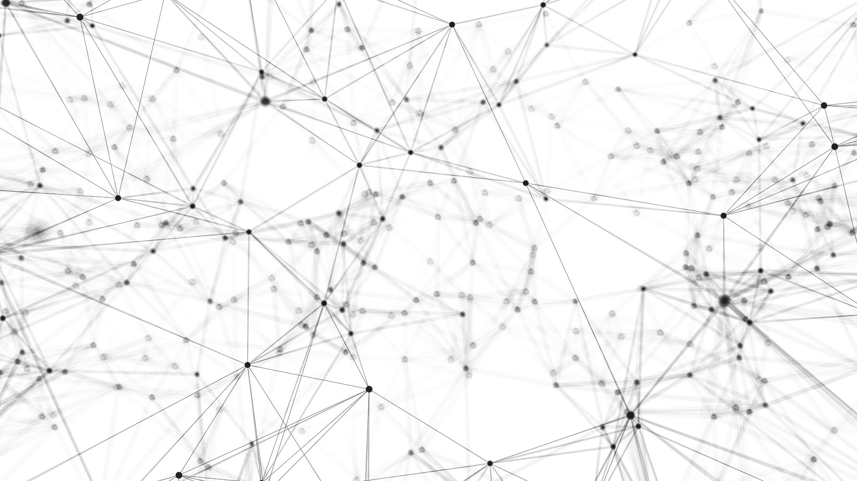
Introduction to AI, Spring 2023 Unsupervised Learning

Slide 2
Unsupervised Learning
So far, everything we’ve discussed has been an example of supervised learning.
We have a lot of examples with labels, we use them to train a model which can then be used to apply labels to new, unlabeled examples.
But sometimes we don’t have labelled data! But we still might want to find patterns within the non-labelled examples we have! For this, we need to depend on unsupervised learning techniques.

Slide 3
Unsupervised Learning
Sometimes in this situation, we don’t even know if labels exist!
E.g., we have 10,000 fruit examples, but we don’t know how many groupings there are
Melon? Citrus? Other sub-categories? We don’t necessarily know ahead of time!
Sometimes we do know that labels exist, but we don’t know which examples have which labels.
E.g., we know we are working with “Melons” and “Citrus”, but we don’t know which label applies to which example.

Slide 4
Clustering
Clustering is an unsupervised learning technique which gathers similar examples into groups (or clusters).
These groups can then just be used directly, or analyzed after they’ve been made to determine their significance.
We’ll consider the simple k-means clustering technique, which automatically discovers k clusters. As with KNN, the value of k here is arbitrary. The technique is often repeated with multiple values of k until satisfactory results are found.

Slide 5
Fruit Data Set
Let’s continue working with fruits! But it’s a little different this time…
Fruit | Sweet | Sour
Lemon | 1 | 5
Lime | 1 | 6
Grapefruit | 2 | 5
Cantaloupe | 4 | 2
Orange | 4 | 3
Honeydew | 5 | 1
Watermelon | 6 | 1
We still have the sweet and sour attributes!
But we are missing the labels! We don’t know which are citrus and which are melons!
Sour
Sweet

Slide 6
Fruit Data Set
But even without labels, we can see that they fall into two groups (or two clusters)!
Fruit | Sweet | Sour
Lemon | 1 | 5
Lime | 1 | 6
Grapefruit | 2 | 5
Cantaloupe | 4 | 2
Orange | 4 | 3
Honeydew | 5 | 1
Watermelon | 6 | 1
Sour
Sweet

Slide 7
Fruit Data Set
Note that these clusters do *not* have a perfect mapping of “citrus” and “melons”
Fruit | Sweet | Sour
Lemon | 1 | 5
Lime | 1 | 6
Grapefruit | 2 | 5
Cantaloupe | 4 | 2
Orange | 4 | 3
Honeydew | 5 | 1
Watermelon | 6 | 1
Sour
It put “Orange” (which you and I know to be Citrus) in a cluster that mainly has melons.
Sweet

Slide 8
Fruit Data Set
When working with clusters, we often care about the Centroids.
The centroid of a cluster is the point that minimizes the average distance to all other points in the cluster
i.e., the ‘center’ of the cluster!
Sour
Sweet

Slide 9
Fruit Data Set
Again, though these clusters roughly correspond to citrus and melon, they aren’t that perfectly!
Moreover, the labels of citrus and melon aren’t even provided! The clusters are just red and green. Or one and two.
It’s up to us humans to figure out what, if any, meaningful variation exists between the groups.
Like, here, the observation would be “hmm, it looks like green group examples tend to exhibit citrus like properties…
And red group examples tend to be melon-esque!
Fruit | Sweet | Sour
Lemon | 1 | 5
Lime | 1 | 6
Grapefruit | 2 | 5
Cantaloupe | 4 | 2
Orange | 4 | 3
Honeydew | 5 | 1
Watermelon | 6 | 1

Slide 10
Lloyd’s Algorithm
Randomly assign each example to a cluster.
Loop:
Recalculate the centroids for each cluster.
Reassign each point to the cluster whose centroid is nearest.
If no points have changed clusters, stop.
Another blissfully simple algorithm!
We’ll use this to perform k-means clustering!
Notes:
Stuart P. Lloyd.

Slide 11
k-Means Example
Let’s do k-Means clustering!
In this example, k will be 2.
This means that there will be 2 clusters, labeled green and red.
Sour
Sweet

Slide 12
k-Means Example
Randomly assign each example to a cluster.
Loop:
Recalculate the centroids for each cluster.
Reassign each point to the cluster whose centroid is nearest.
If no points have changed clusters, stop.
We begin by assigning each example to a random cluster.
Sour
Sweet

Slide 13
Randomly assign each example to a cluster.
Loop:
Recalculate the centroids for each cluster.
Reassign each point to the cluster whose centroid is nearest.
If no points have changed clusters, stop.
k-Means Example
We begin by assigning each example to a random cluster.
By chance, four examples are in the green cluster and three examples are in red.
Sour
Sweet

Slide 14
Randomly assign each example to a cluster.
Loop:
Recalculate the centroids for each cluster.
Reassign each point to the cluster whose centroid is nearest.
If no points have changed clusters, stop.
k-Means Example
We now calculate the centroids of each cluster.
This is just the ‘average value’ of each dimension.
(here we’re working in 2D space, but remember, these could be vectors in any arbitrary n-space).
Sour
Sweet

Slide 15
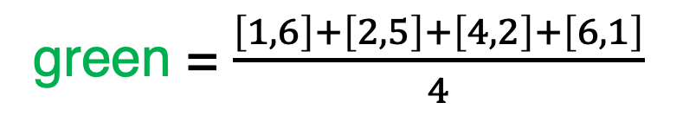
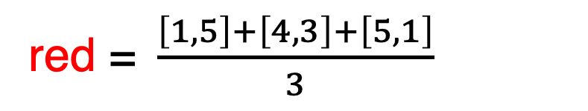
k-Means Example
Randomly assign each example to a cluster.
Loop:
Recalculate the centroids for each cluster.
Reassign each point to the cluster whose centroid is nearest.
If no points have changed clusters, stop.
We now calculate the centroids of each cluster.
green = $\frac{\left[1,6\right]+\left[2,5\right]+\left[4,2\right]+\left[6,1\right]}{4}$
Sour
red = $\frac{\left[1,5\right]+\left[4,3\right]+\left[5,1\right]}{3}$
Sweet

Slide 16
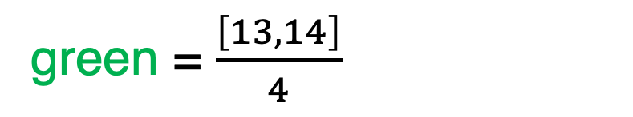
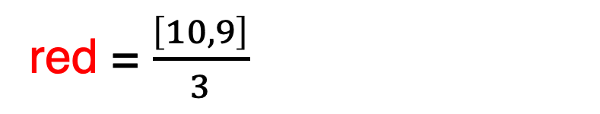
k-Means Example
Randomly assign each example to a cluster.
Loop:
Recalculate the centroids for each cluster.
Reassign each point to the cluster whose centroid is nearest.
If no points have changed clusters, stop.
We now calculate the centroids of each cluster.
green = $\frac{\left[13,14\right]}{4}$
Sour
red = $\frac{\left[10,9\right]}{3}$
Sweet

Slide 17
k-Means Example
Randomly assign each example to a cluster.
Loop:
Recalculate the centroids for each cluster.
Reassign each point to the cluster whose centroid is nearest.
If no points have changed clusters, stop.
We now calculate the centroids of each cluster.
Green Centroid = [3.25,3.50]
Red Centroid = [3.33,3.00]
Sour
Sweet

Slide 18
k-Means Example
Randomly assign each example to a cluster.
Loop:
Recalculate the centroids for each cluster.
Reassign each point to the cluster whose centroid is nearest.
If no points have changed clusters, stop.
Now that we have the centroids, we re-assign each example to the cluster whose centroid it is nearest to.
Sour
Sweet

Slide 19



k-Means Example
Randomly assign each example to a cluster.
Loop:
Recalculate the centroids for each cluster.
Reassign each point to the cluster whose centroid is nearest.
If no points have changed clusters, stop.
Now that we have the centroids, we re-assign each example to the cluster whose centroid it is nearest to.
So the ‘red’ example in the upper left (Lemon) joins team Green.
And the two ‘green’ examples in the lower right (Cantaloupe and Watermelon) join team red.
Sour
Sweet

Slide 20
k-Means Example
Randomly assign each example to a cluster.
Loop:
Recalculate the centroids for each cluster.
Reassign each point to the cluster whose centroid is nearest.
If no points have changed clusters, stop.
If no points changed clusters we’d be done!
But several points changed clusters, so we go through the loop again!
Sour
Sweet

Slide 21
k-Means Example
Randomly assign each example to a cluster.
Loop:
Recalculate the centroids for each cluster.
Reassign each point to the cluster whose centroid is nearest.
If no points have changed clusters, stop.
Now that the contents of the clusters have changed, we need to recalculate the centroid of each cluster.
Sour
Sweet

Slide 22
k-Means Example
Randomly assign each example to a cluster.
Loop:
Recalculate the centroids for each cluster.
Reassign each point to the cluster whose centroid is nearest.
If no points have changed clusters, stop.
Now that the contents of the clusters have changed, we need to recalculate the centroid of each cluster.
They used to be…
Green Centroid = [3.25,3.50]
Sour
Red Centroid = [3.33,3.00]
Sweet

Slide 23
k-Means Example
Randomly assign each example to a cluster.
Loop:
Recalculate the centroids for each cluster.
Reassign each point to the cluster whose centroid is nearest.
If no points have changed clusters, stop.
Now that the contents of the clusters have changed, we need to recalculate the centroid of each cluster.
But after doing the exact same process we did before, they become…
Green Centroid = [1.33,5.33]
Sour
Red Centroid = [4.75,1.75]
Sweet

Slide 24
k-Means Example
Randomly assign each example to a cluster.
Loop:
Recalculate the centroids for each cluster.
Reassign each point to the cluster whose centroid is nearest.
If no points have changed clusters, stop.
We once again re-assign each example to be in the cluster whose centroid is nearest.
Sour
Sweet

Slide 25
k-Means Example
Randomly assign each example to a cluster.
Loop:
Recalculate the centroids for each cluster.
Reassign each point to the cluster whose centroid is nearest.
If no points have changed clusters, stop.
We once again re-assign each example to be in the cluster whose centroid is nearest.
But here, everything is already closest to the centroid whose cluster they are already in!
That means nothing needs to change!
Sour
Sweet

Slide 26
k-Means Example
Randomly assign each example to a cluster.
Loop:
Recalculate the centroids for each cluster.
Reassign each point to the cluster whose centroid is nearest.
If no points have changed clusters, stop.
Because nothing changed, that means we are done!
Sour
Sweet

Slide 27
k-Means Problems
Like KNN Classification, k-means is sensitive to noise and irrelevant attributes.
There are also some kinds of patterns that k-means clusters poorly.

Slide 28
Noise in k-Means
To illustrate the issue of noisy data…
Here’s a new example that isn’t really close to any centroid.
But it has to go somewhere! It needs to belong in “some” cluster!
Sour
Sweet

Slide 29
Noise in k-Means
To illustrate the issue of noisy data…
It’s slightly closer to the green centroid, so put it in team green.
Sour
Sweet

Slide 30
Noise in k-Means
To illustrate the issue of noisy data…
But note how that one outlier now moves the centroid! We could affect which cluster other examples get assigned to!
Sour
Sweet

Slide 31
Shapes in k-Means
To illustrate what we mean by shapes…
y
x

Slide 32
Shapes in k-Means
To illustrate what we mean by shapes…
Your smart human eyes can see two ”groupings” here pretty easily, yeah?
y
x

Slide 33
Shapes in k-Means
To illustrate what we mean by shapes…
Maybe something that looks like this?
But note that these clusters aren’t spherical!
y
x

Slide 34
Shapes in k-Means
To illustrate what we mean by shapes…
k-means clustering defaults to spherical clusters.
But if we do that here, we don’t get this nice grouping. Some things in the “left” shape will jump to team red, and some things in the “right” shape will jump to team green.
y
x

Slide 35
Density-Based Clustering.
As an alternative to k-means clustering, you could use Density-Based Clustering.
In density-based clustering, a cluster is a group of points who are all closer together to one another than other points.
The DBSCAN (Density-Based Spatial Clustering of Applications with Noise) algorithm groups based on density and is resilient to noise!

Slide 36
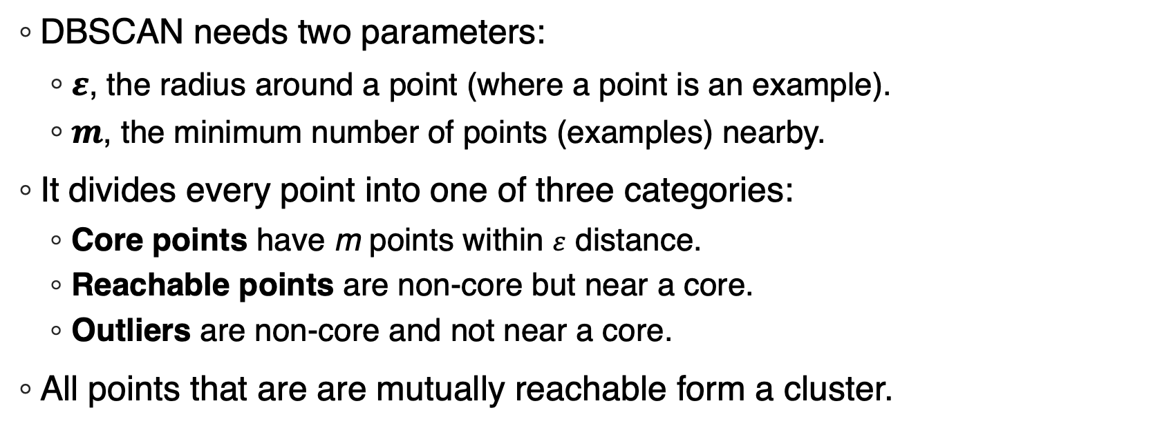
DBSCAN
DBSCAN needs two parameters:
$ε$, the radius around a point (where a point is an example).
$m$, the minimum number of points (examples) nearby.
It divides every point into one of three categories:
Core points have m points within $ε$ distance.
Reachable points are non-core but near a core.
Outliers are non-core and not near a core.
All points that are are mutually reachable form a cluster.

Slide 37
DBSCAN Example
Let’s see how DBSCAN handles this challenge!
y
x

Slide 38
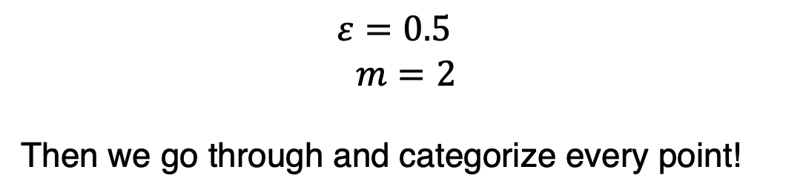
DBSCAN Example
First we specify values for our parameters…
Such as…
$$ε=0.5$$
$$m=2$$
Then we go through and categorize every point!
y
x

Slide 39

DBSCAN Example
Let’s start with this point!
$$ε=0.5$$
$$m=2$$
y
x

Slide 40
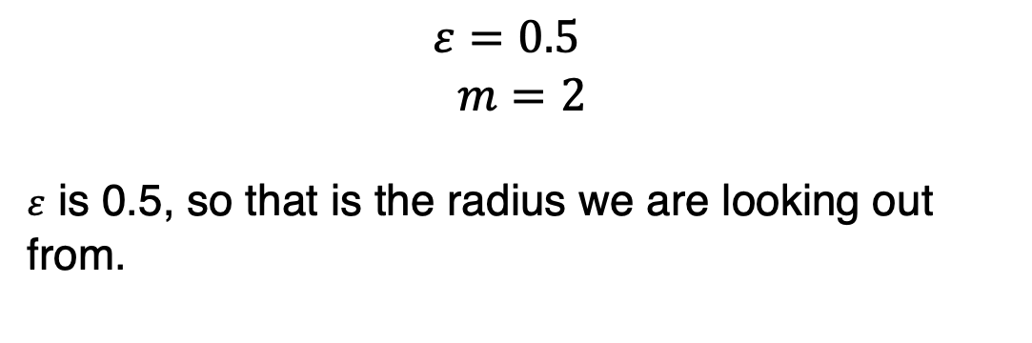
DBSCAN Example
Let’s start with this point!
$$ε=0.5$$
$$m=2$$
$ε$ is 0.5, so that is the radius we are looking out from.
y
x

Slide 41
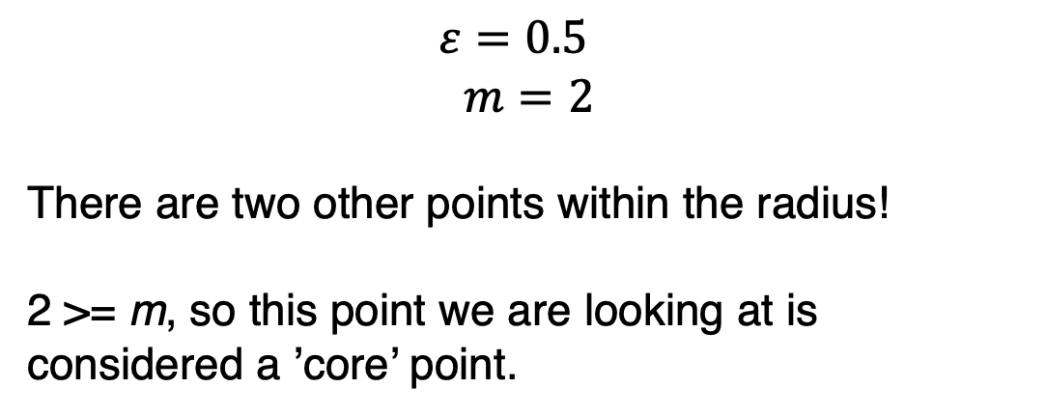
DBSCAN Example
$$ε=0.5$$
$$m=2$$
There are two other points within the radius!
2 >= m, so this point we are looking at is considered a ’core’ point.
y
x

Slide 42
DBSCAN Example
Let’s look at this point now
$$ε=0.5$$
$$m=2$$
y
x

Slide 43
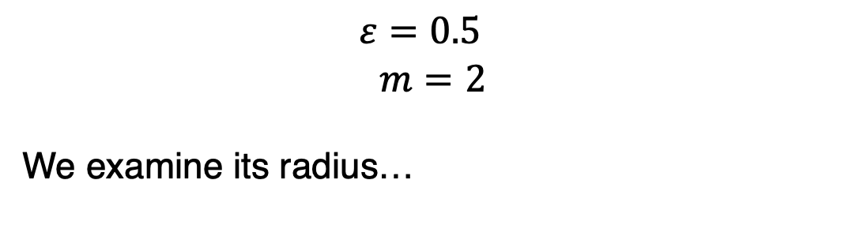
DBSCAN Example
$$ε=0.5$$
$$m=2$$
We examine its radius…
y
x

Slide 44
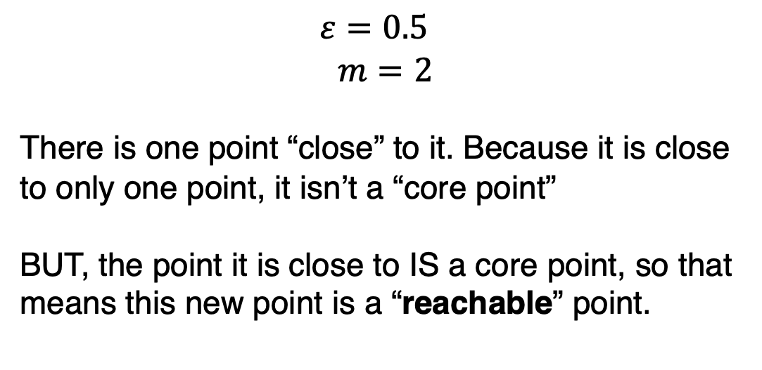
DBSCAN Example
$$ε=0.5$$
$$m=2$$
There is one point “close” to it. Because it is close to only one point, it isn’t a “core point”
BUT, the point it is close to IS a core point, so that means this new point is a “reachable” point.
y
x

Slide 45
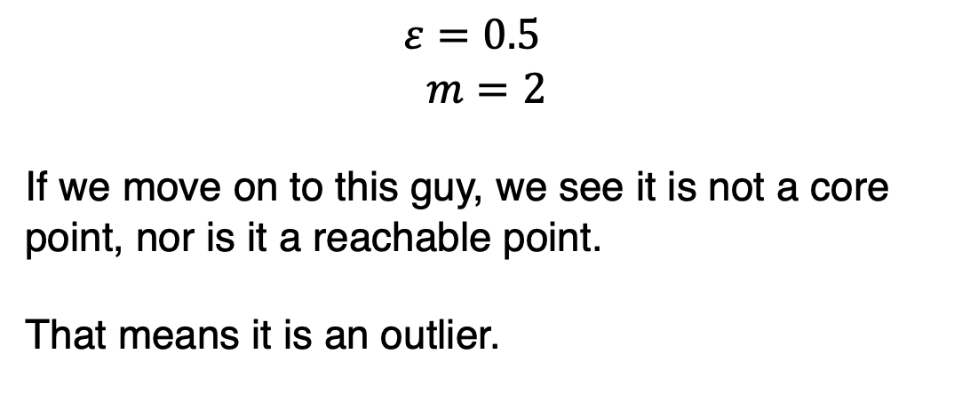
DBSCAN Example
$$ε=0.5$$
$$m=2$$
If we move on to this guy, we see it is not a core point, nor is it a reachable point.
That means it is an outlier.
y
x

Slide 46
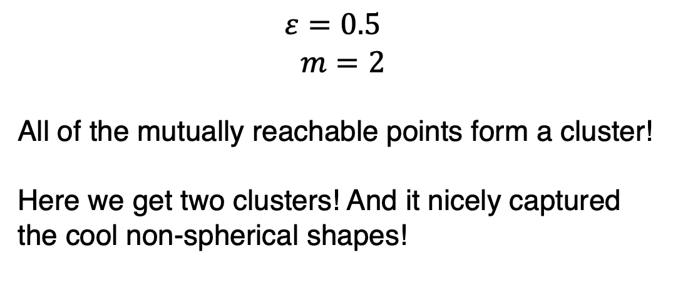
DBSCAN Example
$$ε=0.5$$
$$m=2$$
All of the mutually reachable points form a cluster!
Here we get two clusters! And it nicely captured the cool non-spherical shapes!
y
x

Slide 47
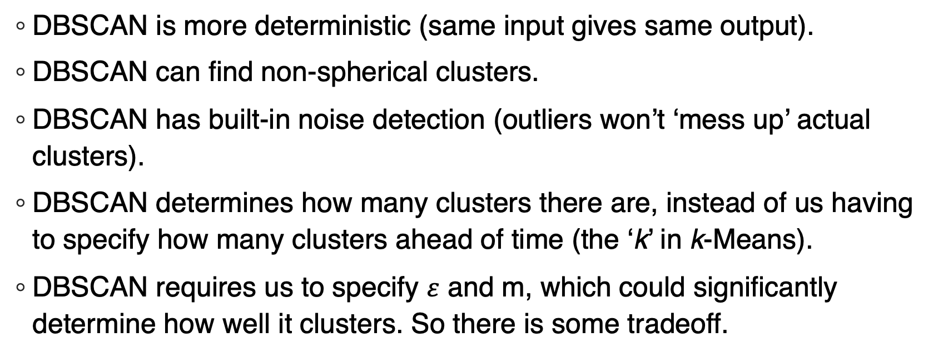
DBSCAN vs k-Means
DBSCAN is more deterministic (same input gives same output).
DBSCAN can find non-spherical clusters.
DBSCAN has built-in noise detection (outliers won’t ‘mess up’ actual clusters).
DBSCAN determines how many clusters there are, instead of us having to specify how many clusters ahead of time (the ‘k’ in k-Means).
DBSCAN requires us to specify $ε$ and m, which could significantly determine how well it clusters. So there is some tradeoff.

